Slide 1
CO Homework 5 CPU

Slide 2
Overview
Implement CPU module
Make sure your codes can execute 17 RISC-V instructions in this homework
Verify your CPU by using Modelsim

Slide 3
Instruction Format
R-type
31 25 | 24 20 | 19 15 | 14 12 | 11 7 | 6 0
funct7 | rs2 | rs1 | funct3 | rd | opcode | Mnemonic | Description
0000000 | rs2 | rs1 | 000 | rd | 0110011 | ADD | rd = rs1 + rs2
0100000 | rs2 | rs1 | 000 | rd | 0110011 | SUB | rd = rs1 - rs2
0000000 | rs2 | rs1 | 100 | rd | 0110011 | XOR | rd = rs1 ^ rs2
0000000 | rs2 | rs1 | 110 | rd | 0110011 | OR | rd = rs1 | rs2
0000000 | rs2 | rs1 | 111 | rd | 0110011 | AND | rd = rs1 & rs2

Slide 4
Instruction Format
I-type
31 20 | 19 15 | 14 12 | 11 7 | 6 0
imm[11:0] | rs1 | funct3 | rd | opcode | Mnemonic | Description
imm[11:0] | rs1 | 010 | rd | 0000011 | LW | rd = M[rs1 + imm]
imm[11:0] | rs1 | 000 | rd | 0010011 | ADDI | rd = rs1 + imm
imm[11:0] | rs1 | 100 | rd | 0010011 | XORI | rd = rs1 ^ imm
imm[11:0] | rs1 | 110 | rd | 0010011 | ORI | rd = rs1 | imm
imm[11:0] | rs1 | 111 | rd | 0010011 | ANDI | rd = rs1 & imm
imm[11:0] | rs1 | 000 | rd | 1100111 | JALR | rd = PC + 4 PC = imm + rs1 (Set LSB of PC to 0)

Slide 5
Instruction Format
S-type
31 25 | 24 20 | 19 15 | 14 12 | 11 7 | 6 0
imm[11:5] | rs2 | rs1 | funct3 | imm[4:0] | opcode | Mnemonic | Description
imm[11:5] | rs2 | rs1 | 010 | imm[4:0] | 0100011 | SW | M[rs1 + imm] = rs2
B-type
31 25 | 24 20 | 19 15 | 14 12 | 11 7 | 6 0
imm[12|10:5] | rs2 | rs1 | funct3 | imm[4:1|11] | opcode | Mnemonic | Description
imm[12|10:5] | rs2 | rs1 | 000 | imm[4:1|11] | 1100011 | BEQ | PC = (rs1 == rs2) ? PC + imm : PC + 4
imm[12|10:5] | rs2 | rs1 | 001 | imm[4:1|11] | 1100011 | BNE | PC = (rs1 != rs2) ? PC + imm : PC + 4

Slide 6
Instruction Format
U-type
31 12 | 11 7 | 6 0
imm[31:12] | rd | opcode | Mnemonic | Description
imm[31:12] | rd | 0010111 | AUIPC | rd = PC + imm
imm[31:12] | rd | 0110111 | LUI | rd = imm
J-type
31 12 | 11 7 | 6 0
imm[20|10:1|11|19:12] | rd | opcode | Mnemonic | Description
imm[20|10:1|11|19:12] | rd | 1101111 | JAL | rd = PC + 4 PC = PC + imm

Slide 7
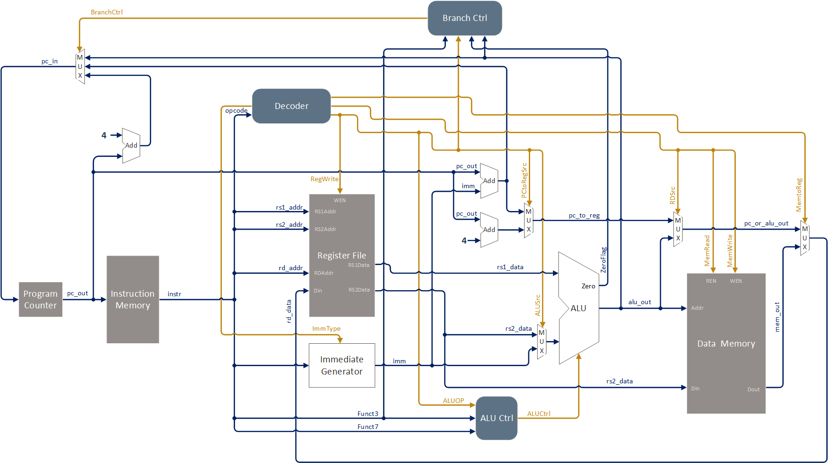
Block Diagram

Slide 8
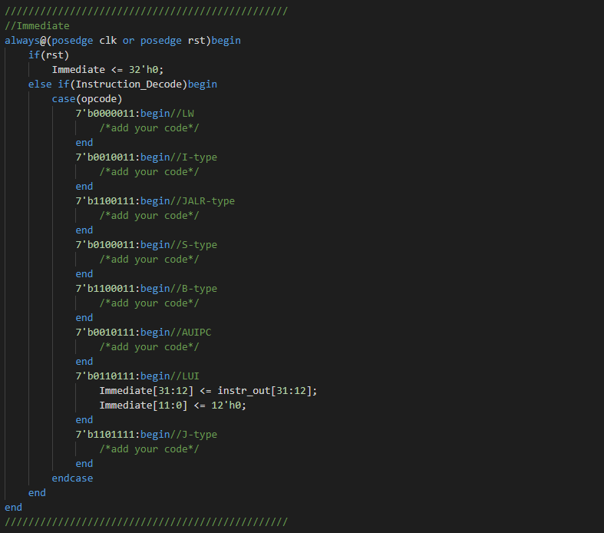
Example

Slide 9
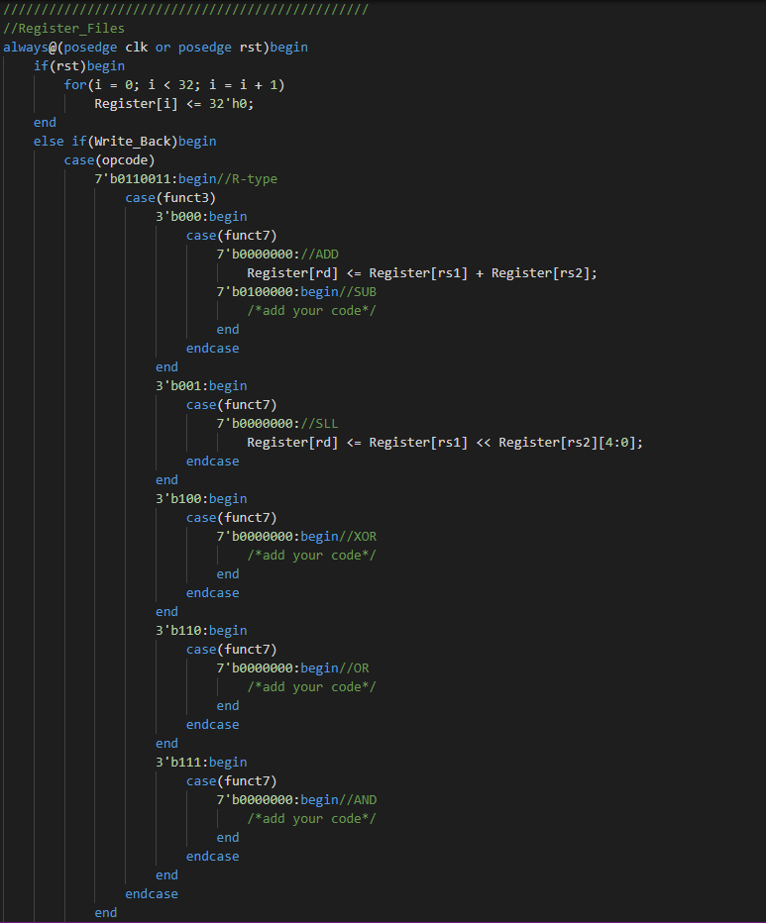
Example

Slide 10
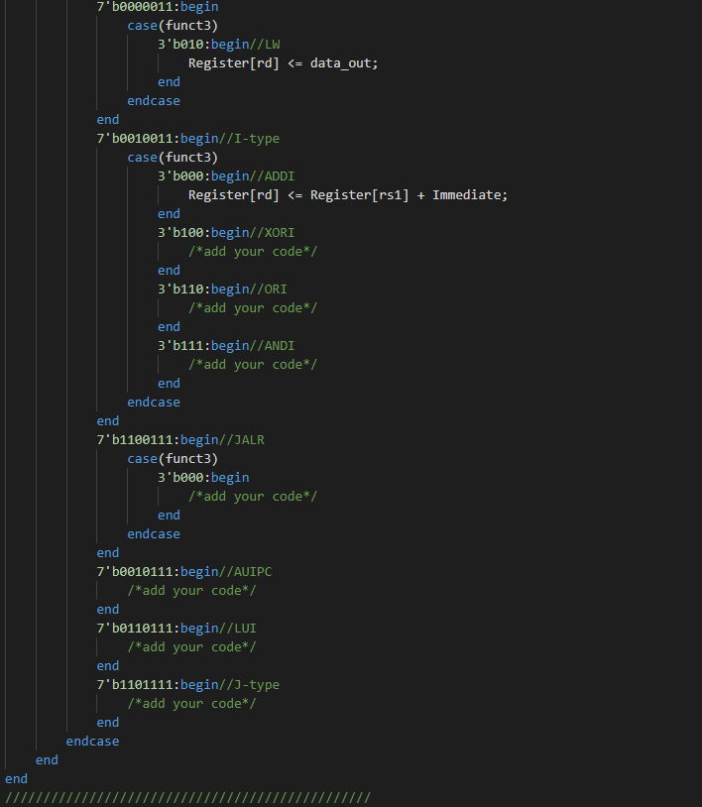
Example

Slide 11
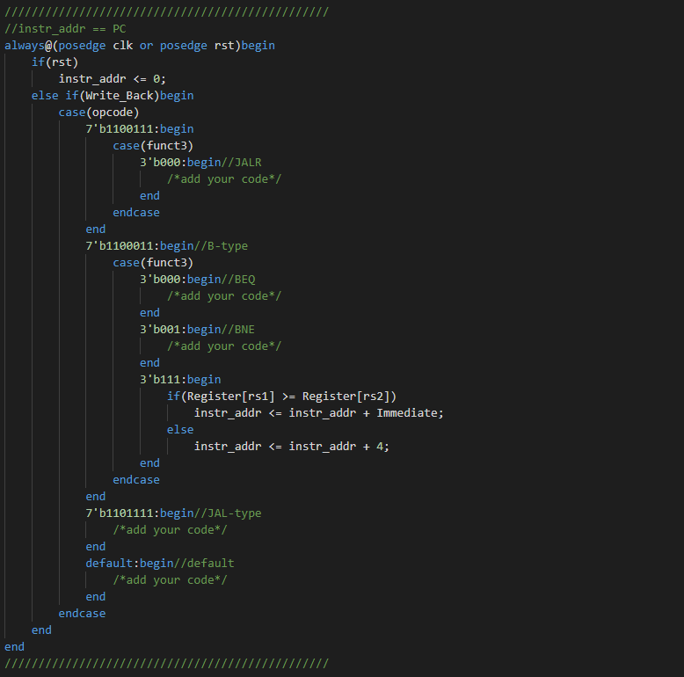
Example

Slide 12
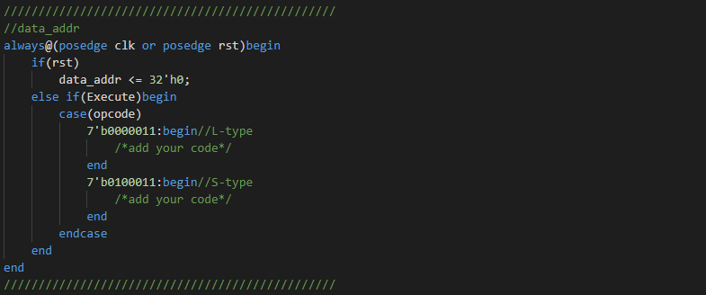
Example

Slide 13
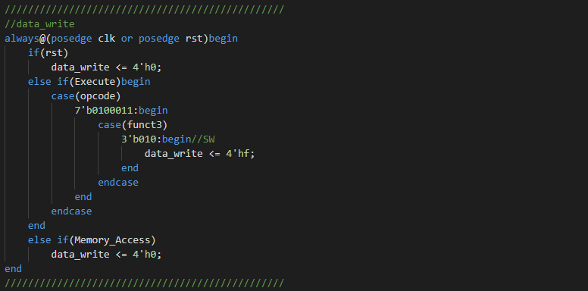
Example

Slide 14
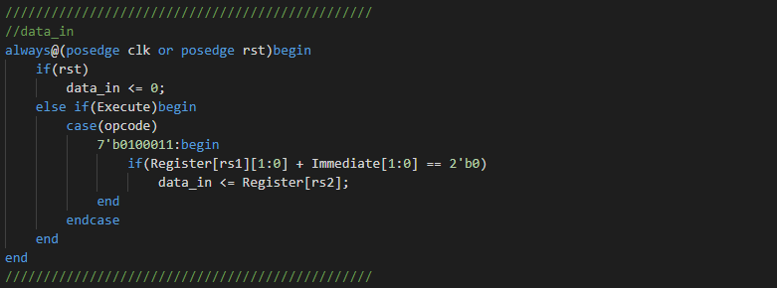
Example

Slide 15
Homework Requirements
Complete the CPU that can execute 17 instructions from the RISC-V ISA section
Verify your CPU with the benchmark and take a snapshot
Finish the Project Report

Slide 16
Score
Your score is divided into two parts:
Functional Simulation (75%):
There are 15 test data, if you pass one of them, you will get 5 points
Report (25%):
take a screenshot of your result, and write your report in “report.docx”

Slide 17
Thanks for listening

